Slide 1

YOUTH CRIME
Year 9 Drama
Lesson 3 – Young Offenders Institution

Slide 2
Lesson Objectives:
To use a live performance as a stimulus.
To learn the necessary skills to work as an ensemble.
To earn achievos by answering questions and contributing ideas or feedback.
Notes:
This scheme of work consists of a series of six lessons based on the exploration of youth crime. It is
hoped that through practical exploration, students will gain a greater understanding of youth crime,
the types of crimes that young people commit, and most importantly why.
By the end of this scheme students will understand more about the law and young offenders, and
the reasons behind young offenders committing crimes. Throughout these lessons students will be
developing drama skills such as scriptwriting and forum theatre. The terminology and skills used
are in line with the Edexcel GCSE specification.

Slide 3
Lesson Outcomes:
I will stay in role during tasks/activities/performances.
I will perform a character different to myself during tasks/activities/performances.
I will confidently use drama techniques (Role Play/Thought Tracking) during my exploration.
I will use P.E.E.E.E.E. when evaluating my own work and the work of my peers.

Slide 4
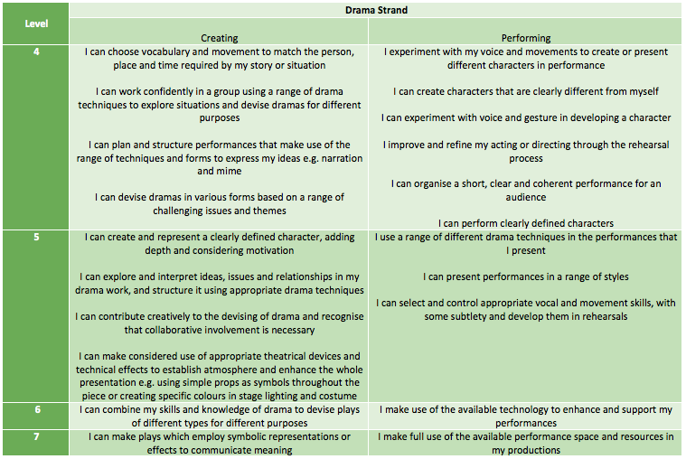
LESSON OUTCOMES

Slide 5
STARTER
3-15 Minutes

Slide 6

PAIR EXPLORE
Fact placards about Young Offenders are laid out on the drama studio floor.
In pairs students are to find a fact and discuss it with their partner using: Think/Pair/Share:
Does the fact surprise you?
Why?
Notes:
As students enter, teacher picks a capable student to be PiR as Marcus. Give them the stage directions placard from the Resources material and explain to them that later in the lesson they will go into role as Marcus.

Slide 7

WHOLE CLASS DISCUSSION
How might Marcus feel going into the YOI (Young Offender Institution) on his first day?
How do the ‘lifers’ feel about Marcus and other new arrivals?

Slide 8
WARM UP
15-30 Minutes

Slide 9
WHOLE CLASS ENSEMBLE
‘We are now going to work as an ensemble to create the dining hall in the Young Offender Institution and you will be the young offenders.’
Teacher to go into the ensemble with students and everyone will work in role.
Consider the following questions while working as an ensemble:
1) What are the difficulties of performing as an ensemble?
2) How was tension built up?
Notes:
Teacher explains the definition of ensemble: ‘Working together as a whole class.’ Make sure this is also displayed somewhere in the room.
1) What are the difficulties of performing as an ensemble? (Proxemics - It is difficult for everyone to see the action.)
2) How was tension built up? (Long pauses and silence.)

Slide 10
ENSEMBLE PIECE
Students form two rows as if sitting at a long table. TiR as a ‘lifer’ and the selected PiR as Marcus arriving on his first day.
Students talk among themselves as young offenders; teacher gets attention of students:
‘Oi, look, there’s one of the new kids. Watch this.’ When this is said students are quiet.
Marcus walks past TiR, who stands up and trips Marcus up.
Pause to create tension. ‘Well, get up then, newbie.’
Freeze.

Slide 11

STOP & QUIZ!
1)What are the difficulties of performing as an ensemble?
(Proxemics - It is difficult for everyone to see the action.)
2)How was tension built up?
(Long pauses and silence.)

Slide 12

QUESTIONS!
How we can overcome these issues of proxemics and tension.
What do you think happened next?
Notes:
Brainstorm answers to both questions on the board.

Slide 13
GROUP WORK
30 - 45 Minutes

Slide 14
GROUP WORK
In groups of 3 or 5. Students now create what happens next.
What characters might be in your scene? (A personal officer? Another young offender? Another new arrival?) You must include Marcus in your performance.
What is the narrative in your scene? (Does another young offender stick up for Marcus, or do they all gang up on the new arrivals?)
What thought-tracking might you include from each character?
Rehearse, thinking about proxemics and how you will build up tension when performing as an ensemble.
Notes:
Give students a few minutes to decide on characters and narrative. Teacher circulates and checks that all students have done both these tasks. Once completed, they can move onto thought-tracking and rehearsing. More able students should be pushed on characterisation.

Slide 15
PERFORM/EVALUATE
45 - 55 Minutes

Slide 16
PERFORM/FEEDBACK
Some groups will perform, think about your proxemics
Students are to give peer feedback using P.E.E.E.E.E
Students are to look at Tension, Proxemics, Ensemble.
REMEMBER
Point (E)
Example (D)
Explain (C)
Explore (C/B)
Expand (B/A)
Evaluate (A)
Notes:
A good way of encouraging all students to participate is to ask them to write their response on a post-it and stick it to the board. The teacher can then select some answers from the board to discuss as a whole class.

Slide 17
PLENARY
55 -60 Minutes

Slide 18
QUESTION TIME
THINK PAIR SHARE WITH SOMEONE YOU HAVEN’T WORKED WITH TODAY
Question: What are the benefits of working as an ensemble?
Notes:
Allow students time to Think/Pair/Share before directly asking for an answer. Challenge more able students to elaborate on their answers, giving reasons for them.

Slide 19
HOW DID YOU DO TODAY?

Slide 20
LESSON OUTCOMES ADD LEVELS and DIFFERENTIATION
I will stay in role during tasks/activities/performances.
I will perform a character different to myself during tasks/activities/performances.
I will confidently use drama techniques (thought tracking/still image) during my exploration.
I will use P.E.E.E.E.E. when evaluating my own work and the work of my peers.

